Slide 1
Introduction of Grid
Yoshio Tanaka, Naotaka Yamamoto
AIST

Slide 2
09:00- 10:00 | Session 1: Plenary Session Welcome Address: Thai Quang Vinh (IOIT/VAST) Opening Remarks: Satoshi Sekiguchi (AIST) Invited Talk: Dao Van Tuyet (IAMI/VAST) Grid computing and some research issues in development GEOGrid at VAST
10:00- 10:30 | Coffee Break
10:30- 12:00 | Session 2: Introduction of Grid Introduction of Grid: Yoshio Tanaka (AIST) Demo: How Grid Security works in GEO Sciences: Naotaka Yamamoto (AIST)
12:00- 13:30 | Lunch
13:30- 14:30 | Session 3: Introduction of GEO Science Introduction of OGC standards: Ryosuke Nakamura (AIST) Demo: Federating Satellite data and Sensor data, Sarawut Ninsawat (AIST)
14:30- 15:15 | Session 4: GEO Activities in PRAGMA The Synergy and Strategy of NARL's GEO: Franz Cheng (NARL) Progress of GEO Research at NARL: Whey-Fone Tsai, Fang-Pang Lin (NCHC)
15:15- 15:45 | Coffee Break
15:45- 17:15 17:15- 17:30 | Session 5: GEO Activities in PRAGMA 1. iGEON: Cyberinfrastructure for Collaborative Research and Education, Arun Agarwal (U. Hyderabad) 2. Live E! (tentative): Seiichi Kato (HUHS) 3. VeRSI Ecoinformatics Climate Change Demonstrator ­ An eResearch approach: A.B.M. Russel (VeRSI) Wrap-up and Closing of GEO Workshop

Slide 3
Outline
Introduction of Grid and Grid Security (Yoshio Tanaka)
  Requirements by applications
    GEO Grid as an example
  Introduction of Grid
  Grid Security Infrastructure (GSI)
  VOMS
  Use cases
How Grid Security works in GEO Sciences (Naotaka Yamamoto)
  Introduction and demonstration of GEO Grid security

Slide 4

Introduction of Grid and its technology
Yoshio Tanaka
National Institute of Advanced Industrial Science and Technology
(AIST), Japan

Slide 5

What is the GEO Grid ?
The GEO (Global Earth Observation) Grid is aiming at providing an E-Science Infrastructure for worldwide Earth Sciences communities to accelerate GEO sciences based on the concept that relevant data and computation are virtually integrated with a certain access control and ease-of-use interface those are enabled by a set of Grid and Web service technologies.
AIST: OGF Gold sponsor (a founding member)
AIST: OGC Associate member (since 2007)
Satellite Data
Grid
Technologies
Geology
Map
Geo* Contents
Applications
GIS data
Resources
Environment
Field data
Disaster
mitigation

Slide 6
GEO Grid
Applications
Disaster
mitigation
Land slides, flood
Environment
monitoring
Global warming, CO₂ flux estimation
Natural resource
exploration
Oil, Gas
Contents
Satellite Imagery
Full L0 ASTER on disk
MODIS on disk (East Asia)
Geology archives
Japan, SE Asia
Sensors
AsiaFlux, Field server
Security, data access, service registry, resource mgmt., Weg GIS, Workflow, U/I Portal, etc.
IT
Infrastructure
Software
Hardware
Storage, Servers
Cluster computers

Slide 7
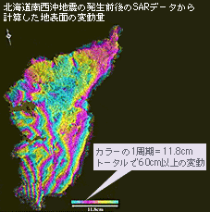
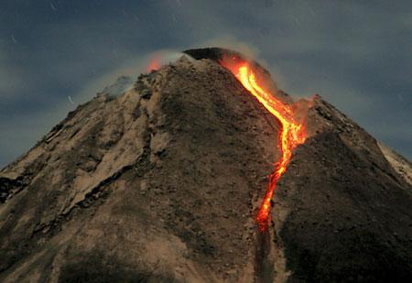
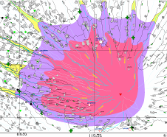
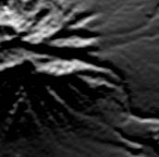
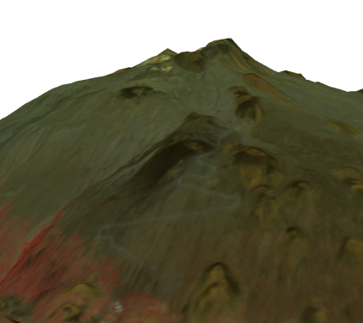
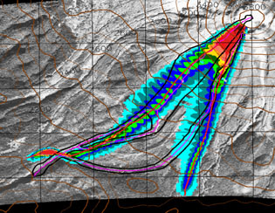

A Workflow example “Disaster prevention and mitigation (Volcano)”
Monitoring of crustal deformation by PALSAR
In-situ observations
e.g. growth of a lava dome
Hazard Map for
Evacuation planning
PALSAR
ASTER
High resolution DEM provided from ASTER
Simulation of lava and/or pyroclastic flow on GEO Grid
Notes:
magnitude

Slide 8
Functional requirements for the IT infrastructure
Size scalability in near-real-time data handling and distribution
  Need to manage hundreds tera-bytes to peta-byte of data.
  Such data will be made available with minimum time delay and at minimum cost.
Handling wide diversification of data types, associated metadata, products and services.
  Research communities wish to integrate various data according to their interests.
  IT infrastructure must support
    the creation of user groups which represent various types of virtual research/business communities
    Federation of distributed and heterogeneous data resources which is shared in such communities

Slide 9
Functional requirements for the IT infrastructure (cont’d)
Respecting data owner’s publication policies
  Some data are not freely accessible.
    E.g. commercial data.
  IT infrastructure must provide a security infrastructure which supports flexible publication policies for both data and computing service providers.
Smooth interaction and loose coupling between data services and computing services
  A desirable IT architectural style would achieve loose coupling among interacting software agents to allow users both to create services independently, and to produce new application from them.
  IT infrastructure must support sharing, coordination, and configuration of environments for application programs and resources, depending on the user’s requirements.

Slide 10
Functional requirements for the IT infrastructure (cont’d)
Ease of use
  End users should be able to access data and computing resources without the burden of installing special software and taking care of security issues (e.g. certificate mgmt.).
  Data and service providers should be able to easily make their resources available as services with desired access control.
  Administrators and leaders of communities should be able to create virtual communities easily by configuring appropriate access control.
  We must provide an ease-of-use framework for publishing services and user interfaces.

Slide 11
Design Policy
Introduces a concept of VO (Virtual Organization)
Data and computation are provided as “services” via standard protocols and APIs.
A VO is created dynamically by integrating available services and resources according to the interests and requirements of the VO.
User-level Authentication and VO-level Authorization
  User’s right is managed (assigned) by an administrator of his belonging VO.
  Access control to a service is configured by the service provider according to the publication policy. There are some options of the access control
    VO-level, Group/Role-based, User-level, etc.
  Scalable architecture for the number of users.

Slide 12
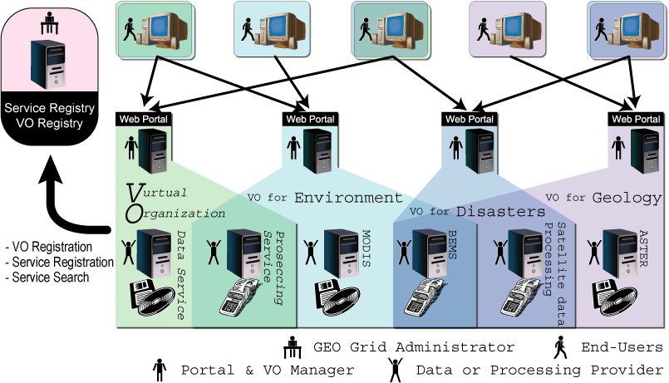
Overview and usage model of the GEO Grid system

Slide 13

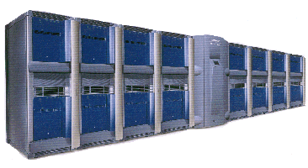
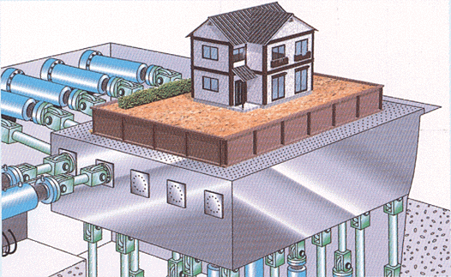
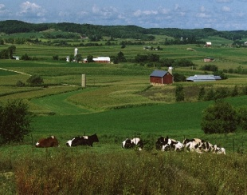
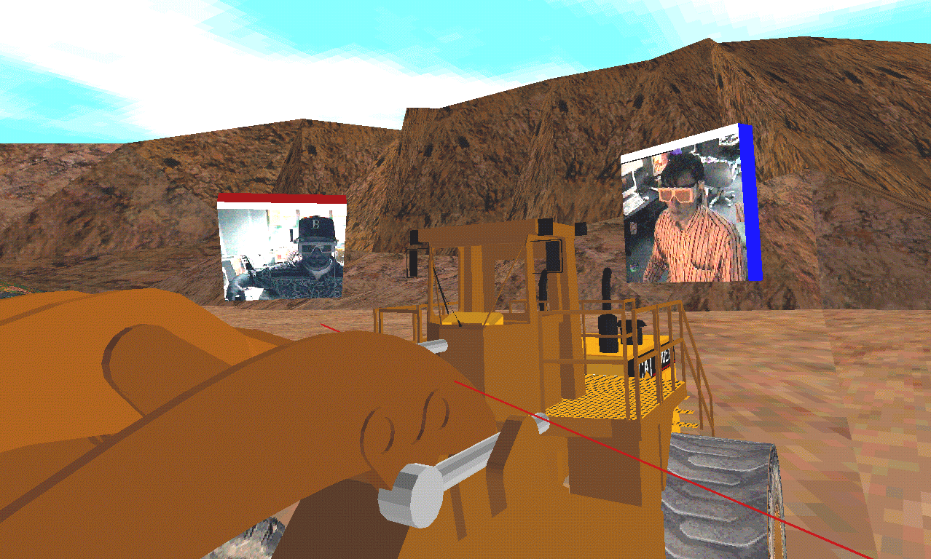
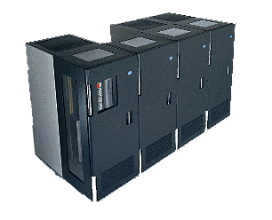
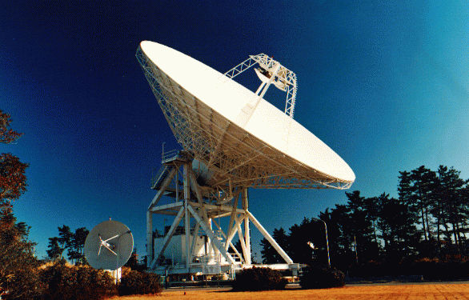
What is Grid?
Flexible, secure, coordinated resource sharing among dynamic collections of individuals, institutions, and resources
  resources include not only computers but various kinds of resources such as databases, networks, sensors, etc.
Secure
Computer
User
Secure
Software
Broadband Network
Sensor Net
Visualization
Experts
Storage
Coordinated
User
User

Slide 14
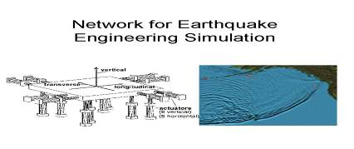







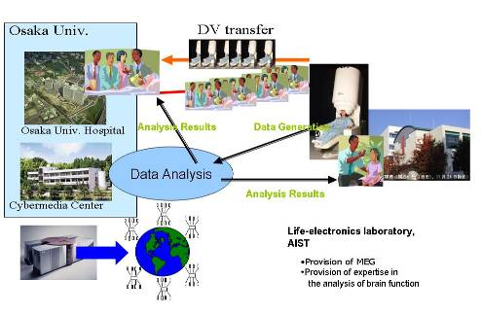
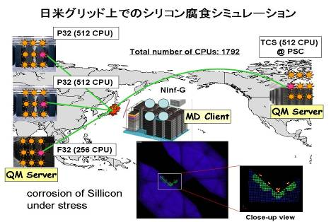
Grid enables e-Science
Huge Data Analysis
Distributed Computing
Geo Science
user
resource
investigation
disaster
prevention
Environment
Satellite
Storage
Web Service: Meta Database
Cluster
Computer
Cluster
Computer
DB @
Thailand
DB @
Japan
Mirror DB
Data Grid: Grid File Systems
Medical Grid
Metacomputing
Multiscale simulation across the Pacific

Slide 15
Virtual Organizations
Distributed resources and people
Linked by networks, crossing admin domains
Sharing resources, common goals
Dynamic
R
R
R
R
R
R
R
R
R
R
R
R
R
R
VO-A
VO-B
This slide is by courtesy of Ian Foster @ ANL

Slide 16
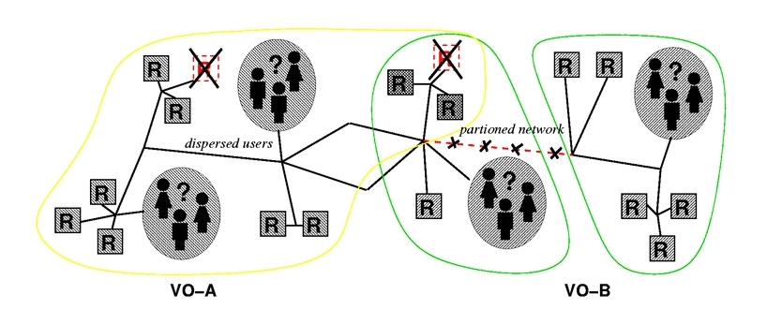
Again, what is Grid?
Resource sharing & coordinated problem solving in dynamic, multi-institutional virtual organizations
  Communities committed to common goals
    Assemble team with heterogeneous members & capabilities
    Distribute across geography and organization
This slide is by courtesy of Ian Foster @ ANL

Slide 17
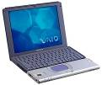

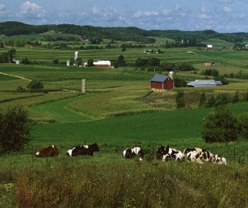
Web for Computing and Information
http://
Web:
Access to HTML documents (static)
http://
Software
catalogs
Grid:
High performance and flexible access to various resources on the Network
Computers
Sensor nets
Colleagues
Data archives
This slide is by courtesy of Ian Foster @ ANL

Slide 18
Key Technologies: GSI and VOMS
Grid Security Infrastructure (GSI) is standard security technology used in the current Grid communities.
  Based on Public Key Infrastructure (PKI) and X.509 Certificates.
Virtual Organization Membership Services (VOMS) is a software for creating/managing VOs.
  Developed by European Communities
  Based on GSI
End users of GEO Grid may not be required to understand GSI, VOMS, etc, but project (VO) admin should understand these technologies correctly.

Slide 19
GSI: Grid Security Infrastructure
Authentication and authorization using standard protocols and their extensions.
  Authentication: Identify the entity
  Authorization: Establishing rights
Standards
  PKI, X.509, SSL,…
Extensions: Single sign on and delegation
  Entering pass phrase is required only once
  Implemented by proxy certificates

Slide 20
PKI and X.509 certificate
Public Key Infrastructure （a pair of asymmetric keys）
  Private key is used for data encryption
  Public key is used for data decryption
Every entity (users, computers, etc.) is required to obtain his/its certificate issued by a trusted Certificate Authority (CA)
X.509 certificates contain
  Name of Subject
  Public key of Subject
  Name of Certificate Authority (CA)
  which has signed it, to match key and identity
  Digital Signature of the signing CA
Certificate
Subject DN
Public Key
Issuer (CA)
Digital Signature

Slide 21


PKI and X.509 certificate (cont’d)
X.509 certificates
  Similar to a driving license. Photo on the license corresponds to a public key.
  issued by a CA
  Validity of the certificate depends on the opposite entity’s policy
NAME: Taro Sanso
User Certificate
Subject DN
Public Key
Issuer (CA)
Digital Signature
Address: 1-1-1, Umezono, Tsukuba
Valid until Dec. 31, 2013
Issued by a CA
Issued by a state/prefecture
private key
(encrypted)
Identify the entity

Slide 22
How a user is authenticated by a server
user
server
User Cert.
Subject DN
Public Key
Issuer (CA)
Digital Signature
User Cert.
Subject DN
Public Key
Issuer (CA)
Digital Signature
Public Key
of the CA
Send Cert.
private key
(encrypted)
QAZWSXEDC…
challenge string
QAZWSXEDC…
encrypted
challenge string
Public Key
PL<OKNIJBN…
QAZWSXEDC…

Slide 23
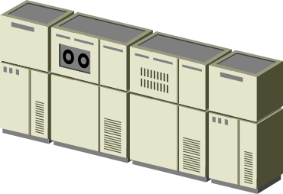

Requirements for Grid security
Single
Sign on
user
server A
server B
remote process
creation requests*
Communication*
Delegation
Remote file
access requests*
* with mutual authentication

Slide 24
X.509 Proxy Certificate
Defines how a short term, restricted credential can be created from a normal, long-term X.509 credential
  A “proxy certificate” is a special type of X.509 certificate that is signed by the normal end entity cert, or by another proxy
  Supports single sign-on & delegation through “impersonation”

Slide 25
User Proxies
Minimize exposure of user’s private key
A temporary, X.509 proxy credential for use by our computations
  We call this a user proxy certificate
  Allows process to act on behalf of user
  User-signed user proxy cert stored in local file
  Created via “grid-proxy-init” command
Proxy’s private key is not encrypted
  Rely on file system security, proxy certificate file must be readable only by the owner

Slide 26
User Proxies (cont’d)
Identity of the user
Proxy Certificate
Subject DN/Proxy
(new) public key
(new) private key
(not encrypted)
Issuer (user)
Digital Signature (user)
User Certificate
Subject DN
Public Key
Issuer (CA)
Digital Signature
grid-proxy-init
User Certificate
Subject DN
Public Key
Issuer (CA)
Digital Signature
private key
(encrypted)
sign

Slide 27
Delegation
Remote creation of a user proxy
Results in a new private key and X.509 proxy certificate, signed by the original key
Allows remote process to act on behalf of the user
Avoids sending passwords or private keys across the network
Proxy-1
Public
Key
Proxy-1
Private
key
Proxy-2
public
Proxy-2
private
User
Private
Proxy-2
public
Proxy-1
Private
grid-proxy-init
Client
Server
Proxy-2
Public
User
Public
Key
User
Private
key
Proxy-1
private
CA
Private

Slide 28

Traverse Certificate Chain to verify identity
User Identity
CA
User
Certificate
User Identity
CA
User
Certificate
Proxy
Certificate
User Identity
CA
User
Certificate
Proxy
Certificate
Proxy
Certificate

Slide 29
Requirements for users
Obtain a certificate issued by a trusted CA
  Globus CA can be used for tests
  Run another CA for production run. The certificate and the signing policy file of the CA should be put on an appropriate directory (/etc/grid-security/certificates).
Create a Proxy Certificate in advance
  Need to enter pass phrase for the decryption of a private key.
    Only onece!
  A proxy certificate will be used for further authentication.

Slide 30
Server side AuthN + AuthZ
Authentication based on SSL challenge-string protocol.
Authorization by checking if the user is registered in /etc/grid-security/grid-mapfile.
If the user is registered, the user is mapped to the corresponding UNIX account.
“/C=JP/O=AIST/O=GRID/CN=Yoshio Tanaka” yoshio
“/C=JP/O=AIST/O=GRID/CN=Ryosuke Nakamura” ryosuke
…..

Slide 31
Summary of GSI
Every entity has to obtain a certificate.
Treat your private key carefully!!
  Private key is stored only in well-guarded places, and only in encrypted form
Create a user proxy in advance
  Run grid-proxy-init command
  virtual login to Grid environment
  A proxy certificate will be generated on user’s machine.
Single sign on and delegation enable easy and secure access to remote resources.

Slide 32
What’s the role of VOMS?
GSI provides basic technology for authentication (who is the user).
  The other framework is necessary for authorization (what the user can do).
The most naive approach is to map each user to each local account on each server.
  What happens if there are thousands to millions of users?
“/C=JP/O=AIST/O=GRID/CN=Yoshio Tanaka” yoshio
“/C=JP/O=AIST/O=GRID/CN=Ryosuke Nakamura” ryosuke
…..

Slide 33
What’s the role of VOMS? (cont’d)
VOMS provides a mechanism for VO-based authorization.
  Users are registered to VO(s)
  Users can belong to Group(s) in the VO
  Users can be assigned role(s)
  Service providers can configure the system to control access based on
    VO-base
      All users in a VO can access to the service
    Group-base
      Users in a specific group can access to the services
    Group&Role-base
      Users in a specific group with specific role can access to the services
It is implemented by embedding “VOMS attributes” in user’s proxy certificate.

Slide 34
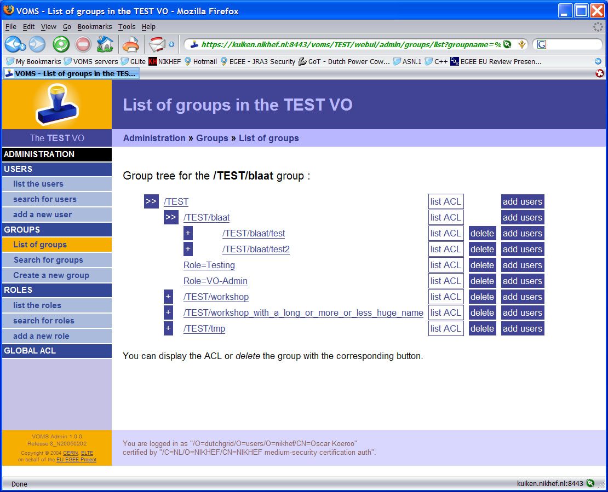
VOMS adds Group and Role structure

Slide 35








VOMS
high frequency
low frequency
CA
CA
CA
optinal low frequency
host cert
(long life)
user
service
crl update
user cert
(long life)
registration
VOMS
voms-proxy-init
proxy cert
(short life)
grid-mapfile & groupmapfile
authz cert
(short life)
authentication & authorization info
PRIMA/GUMS
LCAS
LCMAPS

Slide 36
In-depth view on VOMS
AC as defined by RFC 3281
  VOMS OID: 1.3.6.1.4.1.8005.100.100
  To prevent the stealing of VOMS ACs and other sec. measures:
    DN of Attribute Holder linked into the ACs
    Serial Number of User Certificate linked into the ACs
    ACs have their own Validity period
  ACs are signed by the private key of the VOMS Server Host certificate
    Nothing prevents the use of a service certificate or user certificates instead of host certs in this signing process
The Authorization tokens are listed as FQANs in the AC
  FQAN: Fully Qualified Attribute Name
  Example:
  /pragma-grid.net/GEOGrid/Role=admin/Capability=NULL

Slide 37
Sequence of voms-proxy-init (example)
voms-proxy-init --voms voms.pragma-grid.net
  Optionally: the voms-proxy-init command can be extended to request Roles to be added
Create temp. proxy for GSI connection to ‘vomsd’ on voms.pragma-grid.net
Perform GSI connection to ‘vomsd’
  Performs the regular checks
  vomsd uses the User DN (and Issuer DN) and searches the database for groups (and Roles (and Capabilities))
  Constructing the VOMS ACs and signing the ACs
  Sending back the signed attributes to the client
Create a new proxy certificate and include the returned VOMS ACs into the new proxy

Slide 38
Site Security with VOMS aware tools
mk-gridmapfile
  Retrieve information from VOMS server and create grid-mapfile.
LCAS/LCMAPS can be used for AuthZ and user mapping functionality in the edg-gatekeeper and edg-gridFTP
  Currently available as LCG software
  GT-4 interface to LCAS and LCMAPS is available
PRIMA, SAZ and GUMS
  Prima is the library that dispatches the credential checks to SAZ and the identity mapping to GUMS
  GUMS uses an extended SAML protocol
Both LCMAPS and GUMS are capable of mapping users to
  a group (shared) account
  pool accounts
  individual user’s account

Slide 39
Example: How VOMS is used in PRAGMA Grid
- When a new user joins to PRAGMA Grid… -
Before using VOMS in PRAGMA Grid
  The user have to prepare a “user pack” which includes
    ssh public key for remote login to PRAGMA resources
    preferable account name
    Subject DN of the user certificate
    etc.
  Each site admin have to create an account for the user
    Create a UNIX account and deploy ssh public key
    Add the user’s entry in grid-mapfile
  The user have to confirm if he can login to each resource
    If there is a problem, the user have to consult site admin one by one.

Slide 40
Example: How VOMS is used in PRAGMA Grid
After VOMS is introduced in PRAGMA Grid
  VO admin launched PRAGMA VO
  Site admins installed VOMS-aware tools for AuthZ
  Site admins configured VOMS-aware tools according to the policy
    E.g. mapping to shared and/or individual (pool) accounts
  When a new Group is created
    VO admin creates a new group and assign group administrators
    Each site change the configuration of VOMS-aware tool to accept the new group
  When a new user joins to PRAGMA Grid
    The group admin add the user to VOMS/Group
      Site admins do not need to create the user’s account!

Slide 41
Overview and usage model of the GEO Grid system
User-level Authentication and VO-level Authorization
  User’s right is managed (assigned) by an administrator of his belonging VO.
  Access control to a service is configured by the service provider according to the publication policy. There are some options of the access control
    VO-level, Group/Role-based, User-level, etc.
  Scalable architecture for the number of users.

Slide 42
Summary
Introduce Grid, Grid Security (GSI), and VOMS
  Security is a key component of Grid to create a VO
GSI
  PKI + X.509 certificate –based security infrastructure
  End entities (user, host, etc.) have to have their own certificates
  Each user has to generate a proxy certificate for single sign-on and delegation
VOMS
  VOMS creates/manages VO for authorization
  Enables VO-level/Group-level/Role-level/Individual-level authorization

Slide 43

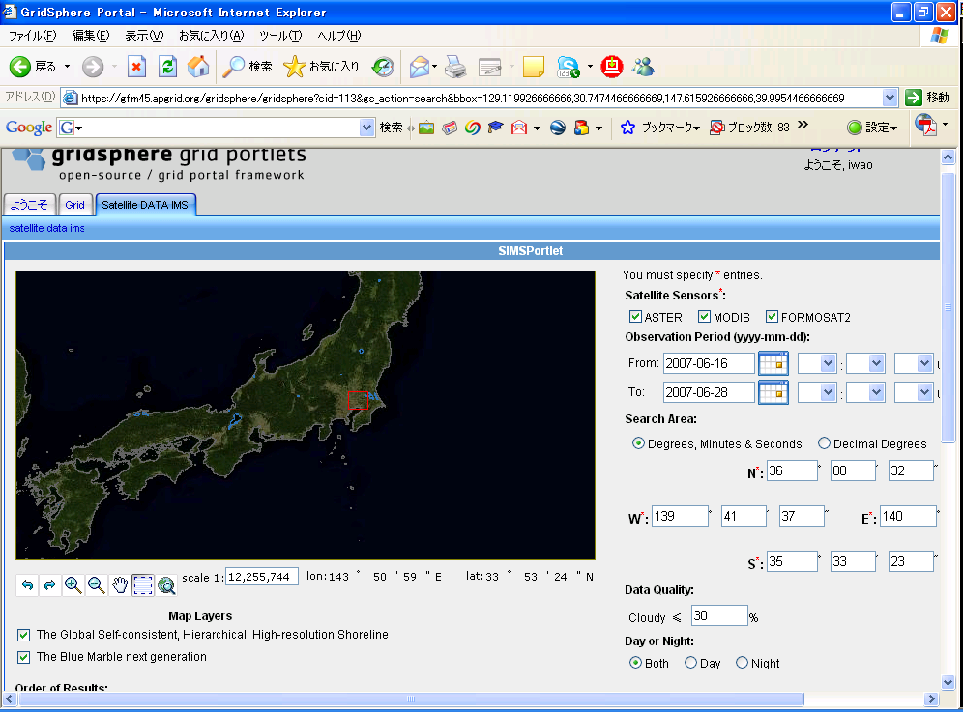


login
Account
DB
user
Terra/ASTER
account (GAMA)
server
VO DB
TDRS
credential
VO (VOMS)
server
APAN/TransPAC
portal server
GET
exec
query
GSI +
VOMS
ERSDIS/NASA
GSI + VOMS
GSI + VOMS
CSW
OGSA
DAI
WFS
WCS
WMS
GRAM
GridFTP
GIS
server
map
server
catalogue/
metadata
server
gateway
server
GEO Grid Cluster
L0
L0
L0
L0
L0
L0
L0
L0
Data
Maps
Meta data
Storage
(DEM)
L0
L0
L0
L0

Slide 44
Hand over to the next talk…
How user’s certificates/credentials should be managed at client side? For example, in portal architecture?
Yamamoto-san will demonstrate a credential management system.
The demo is a joint demonstration by AIST and NARL/NSPO/NCHC
  Show the federation of ASTER and MODIS data in AIST and Formsat-2 data in NSPO.
Special thanks to..
  Bo Chen and Fifi (NSPO) and David Chung (NCHC) for setting up F2 servers for us.
  Franz Cheng (NARL) and Whey-Fone Tsai (NCHC) for exchanging JRC between NARL and AIST.

